Slide 1
Batch Processing is defined as
The Processing of Data without interaction.

Slide 2
Spring Batch, is an open source framework for batch processing – execution of a series of jobs. Spring Batch provides classes and APIs to read/write resources, transaction management, job processing statistics, job restart and partitioning techniques to process high-volume of data.

Slide 3
Spring Batch is a lightweight, comprehensive batch framework designed to enable the development of robust batch applications vital for the daily operations of enterprise systems. Spring Batch builds upon the productivity, POJO-based development approach, and general ease of use capabilities people have come to know from the Spring Framework, while making it easy for developers to access and leverage more advance enterprise services when necessary. Spring Batch is not a scheduling framework. There are many good enterprise schedulers available in both the commercial and open source spaces such as Quartz, Tivoli, Control-M, etc. It is intended to work in conjunction with a scheduler, not replace a schedule

Slide 4
Spring Batch provides reusable functions that are essential in processing large volumes of records, including logging/tracing, transaction management, job processing statistics, job restart, skip, and resource management. It also provides more advance technical services and features that will enable extremely high-volume and high performance batch jobs though optimization and partitioning techniques. Simple as well as complex, high-volume batch jobs can leverage the framework in a highly scalable manner to process significant volumes of information.

Slide 5
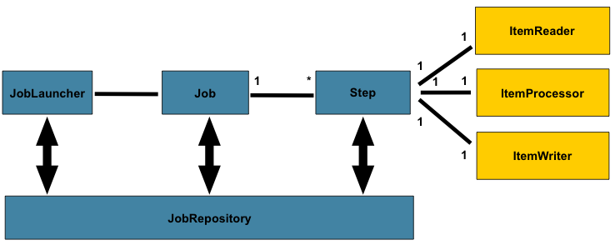

Slide 6
Step1
Step2
Step3
ItemReader
ItemReader
ItemReader
ItemProcessor
ItemProcessor
ItemProcessor
ItemWriter
ItemWriter
ItemWriter

Slide 7
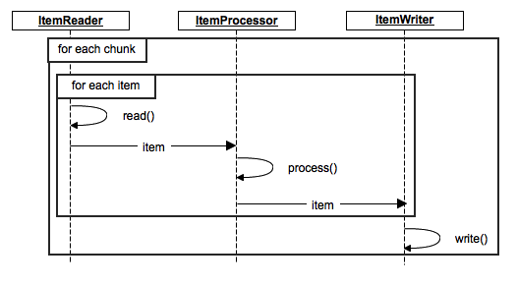

Slide 8
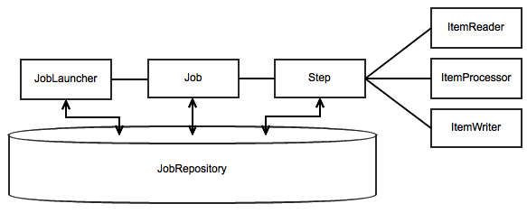

Slide 9
Multithreaded Step
Step1
Step2
Step3
Step2
Step2
ItemReader
ItemReader
ItemReader
ItemReader
ItemReader
ItemProcessor
ItemProcessor
ItemProcessor
ItemProcessor
ItemProcessor
ItemWriter
ItemWriter
ItemWriter
ItemWriter
ItemWriter

Slide 10
Parallel Steps
Step2
ItemReader
ItemProcessor
Step1
Step4
ItemWriter
ItemReader
ItemReader
ItemProcessor
ItemProcessor
Step3
ItemWriter
ItemWriter
ItemReader
ItemProcessor
ItemWriter

Slide 11
Remote Chunking
Step1
Step2
Step4
ItemReader
ItemReader
ItemReader
ItemProcessor
ItemProcessor
ItemWriter
ItemWriter
ItemWriter
Step2a
Step2b
Step2c
ItemReader
ItemReader
ItemReader
ItemProcessor
ItemProcessor
ItemProcessor
ItemWriter
ItemWriter
ItemWriter

Slide 12
Remote Partitioning
Step1
Master
Step3
ItemReader
ItemReader
ItemProcessor
Partitioner
ItemProcessor
ItemWriter
ItemWriter
Slave 1
Slave 2
Slave 3
ItemReader
ItemReader
ItemReader
ItemProcessor
ItemProcessor
ItemProcessor
ItemWriter
ItemWriter
ItemWriter

Slide 13
Features include:
Transaction management
Chunk based processing
Declarative I/O
Start/Restart/Skip capabilities
Web administration interface
Based on the Spring framework
Notes:
Reusable components for the following
Chunk based processing
I/O – Declaritive
Start/Restart/Skip capabilities
Transaction management
Web administration interface

Slide 14
Spring Batch - Difference between Step, Chunk and Tasklet
A Step is a domain object that encapsulates an independent, sequential phase of a batch job and contains all of the information necessary to define and control the actual batch processing. Steps can be processed in either of the following two ways.
Chunk
Tasklet

Slide 15
step - A Step that delegates to a Job to do its work. This is a great tool for managing dependencies between jobs, and also to modularise complex step logic into something that is testable in isolation. The job is executed with parameters that can be extracted from the step execution, hence this step can also be usefully used as the worker in a parallel or partitioned execution.
Notes:
step - A Step that delegates to a Job to do its work. This is a great tool for managing dependencies between jobs, and also to modularise complex step logic into something that is testable in isolation. The job is executed with parameters that can be extracted from the step execution, hence this step can also be usefully used as the worker in a parallel or partitioned execution.
ItemReader - Strategy interface for providing the data. Implementations are expected to be stateful and will be called multiple times for each batch, with each call to read() returning a different value and finally returning null when all input data is exhausted. Implementations need not be thread-safe and clients of a ItemReader need to be aware that this is the case. A richer interface (e.g. with a look ahead or peek) is not feasible because we need to support transactions in an asynchronous batch.
ItemProcessor - Interface for item transformation. Given an item as input, this interface provides an extension point which allows for the application of business logic in an item oriented processing scenario. It should be noted that while it's possible to return a different type than the one provided, it's not strictly necessary. Furthermore, returning null indicates that the item should not be continued to be processed.
ItemStreamWriter - Basic interface for generic output operations. Class implementing this interface will be responsible for serializing objects as necessary. Generally, it is responsibility of implementing class to decide which technology to use for mapping and how it should be configured. The write method is responsible for making sure that any internal buffers are flushed. If a transaction is active it will also usually be necessary to discard the output on a subsequent rollback. The resource to which the writer is sending data should normally be able to handle this itself.

Slide 16
ItemReader - Strategy interface for providing the data. Implementations are expected to be stateful and will be called multiple times for each batch, with each call to read() returning a different value and finally returning null when all input data is exhausted. Implementations need not be thread-safe and clients of a ItemReader need to be aware that this is the case. A richer interface (e.g. with a look ahead or peek) is not feasible because we need to support transactions in an asynchronous batch.
ItemProcessor - Interface for item transformation. Given an item as input, this interface provides an extension point which allows for the application of business logic in an item oriented processing scenario. It should be noted that while it's possible to return a different type than the one provided, it's not strictly necessary. Furthermore, returning null indicates that the item should not be continued to be processed.
ItemStreamWriter - Basic interface for generic output operations. Class implementing this interface will be responsible for serializing objects as necessary. Generally, it is responsibility of implementing class to decide which technology to use for mapping and how it should be configured. The write method is responsible for making sure that any internal buffers are flushed. If a transaction is active it will also usually be necessary to discard the output on a subsequent rollback. The resource to which the writer is sending data should normally be able to handle this itself.

